Slide 1
Module 3: What are the best words and images to use when communicating with consumers about your locally produced food?

Slide 2
In our previous session we:
Generated a list of motivators and possible barriers to consumer purchase
Generated a list of locations where consumers purchase local food and the reasons they select specific products
Examined your products and determined which foods are most likely to be purchased, potential motivators, and possible market locations
We looked at possible barriers to purchases of the foods you produce and discussed possible strategies for counteracting those barriers

Slide 3
Icebreaker
Try to identify all 10 logos in the blanks on your worksheet
After everyone has had a few minutes to complete the list, we will go around the room to introduce ourselves. Please tell us:
  Your name
  The local food product(s) you produce
  Your answer to the next logo on the page
We will reveal any unknown companies at the end

Slide 4
Agenda
Objectives
Define branding and framing and view examples in research
Determining images and words that shed a positive light on your products
Defining message, determining how to develop effective messages
Analyzing your audience
Summary
Evaluation

Slide 5
Objectives
Understand the concepts of framing and branding.
Identify the words and images consumers might view negatively or positively.
Understand the steps to develop effective messages.
Understand how to develop and test messages for your promotional plan about your products and farm.

Slide 6
Exercise A
Look at the 10 logos and names we discussed in the icebreaker
List the first words or phrases you think of that describe the company
After about 5 minutes, we will compile your input and discuss key points about brands

Slide 7
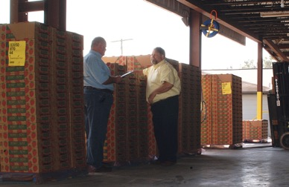
Branding and Framing
Branding – A distinguishing name and/or symbol used to differentiate your product from your competitors
A well-developed brand has a set of communicated impressions that the audience automatically thinks of

Slide 8
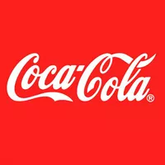
Think for a moment about this brand.
What comes to mind when you think about Coca-Cola?

Slide 9
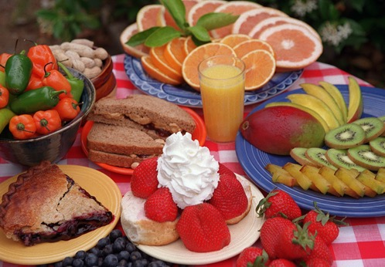
One way you can help develop your brand is to use effective messaging
One of the first steps to effective messaging is to consider framing

Slide 10
Framing – Methods of using words and images to encourage a specific interpretation of your message
Framing is also designed to encourage your audience to see and remember your product in a certain way
Different images and words can bring about certain thoughts and emotions

Slide 13
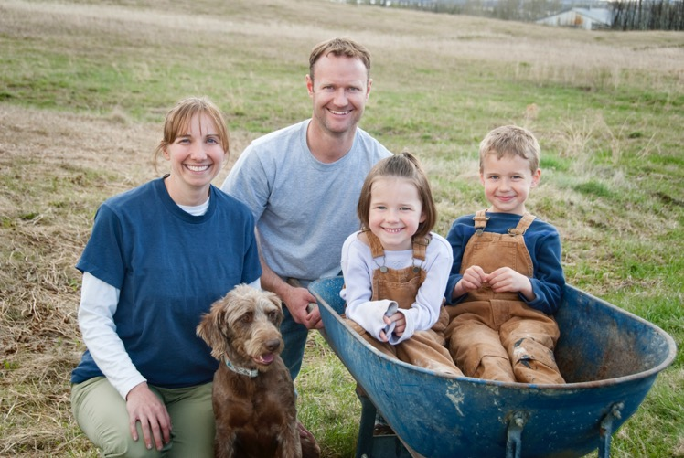

Slide 15
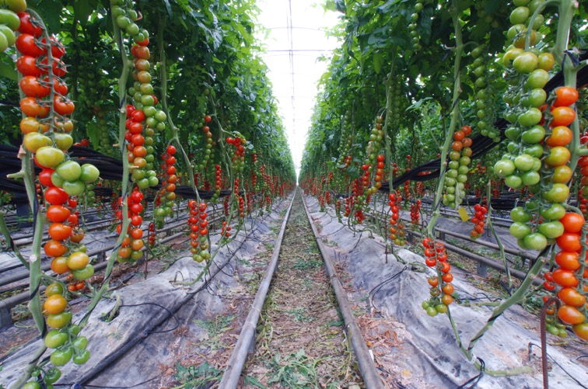

Slide 16



Slide 17
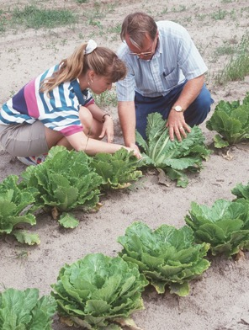
Tips for selecting images
Audiences generally like images of families and children
Show people who look like your target audience
Pictures of the environment and natural resources tend to generate positive responses

Slide 18
Tips for selecting images continued
Audiences like to see pictures of farmers. However, they want the photos to be authentic and transparent rather than staged and unrealistic.
Photos should be accompanied by context to eliminate confusion. For instance the tomato picture could be clarified if accompanied by a brief description of the picture elements.

Slide 19
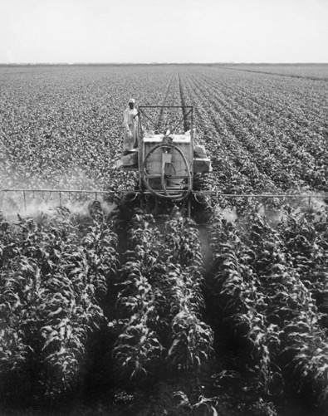
Words you select are also important
Words in your message carry a great deal of weight in creating an impression with potential customers

Slide 20
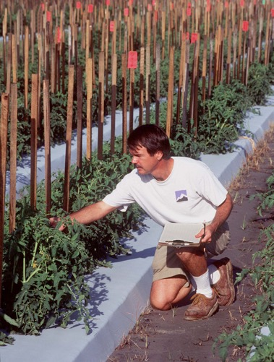
Exercise B
Take a few minutes to record whether the words on the Exercise B worksheet have overall positive or negative connotations.
After you record your own thoughts, we will poll the entire group to compare perspectives.

Slide 21

Farmer
Agribusiness
Locally grown
Farm worker
Agriculture
Family owned

Slide 22
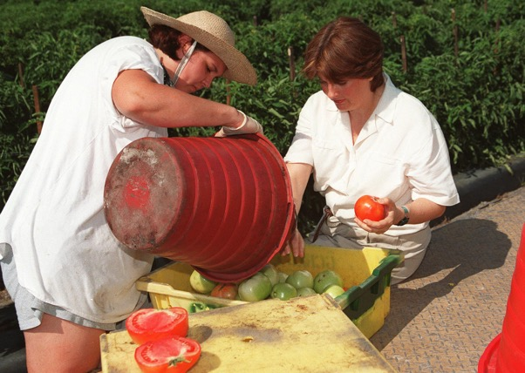
Animal welfare
Food safety
Green industry
Organic

Slide 23
What is a message?
A message is short and easy to understand
It does not use jargon or abbreviations
It can be repeated without being redundant
It can be used as a catch-phrase, tag-line, or slogan
It can be used in a summary

Slide 24
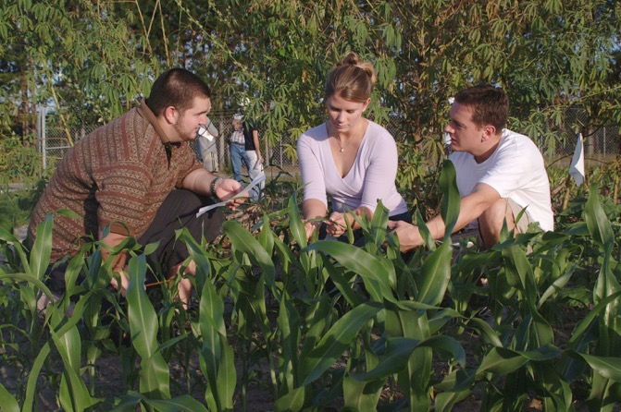
A strong message is:
Focused
Positive
Boiled-down
Targeted to a specific audience

Slide 25
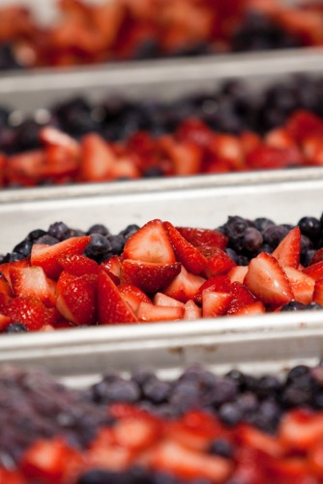
When developing your message:
Identify your general audience
Analyze the audience:
  Demographics
  Interests
  Attitudes
  Life-style

Slide 26
Why it is important to know your audience when developing messages
  KFC’s slogan “finger-licking good” translates to “eat your fingers off” in Chinese
  Schwepps Tonic Water translates into Schwepps Toliet Water in Italian
  Pepsi’s decision to change their vending machines from deep regal blue to ice blue resulted in market share losses to in Southeast Asia
    Light blue in Southeast Asia is associated with death and mourning

Slide 27
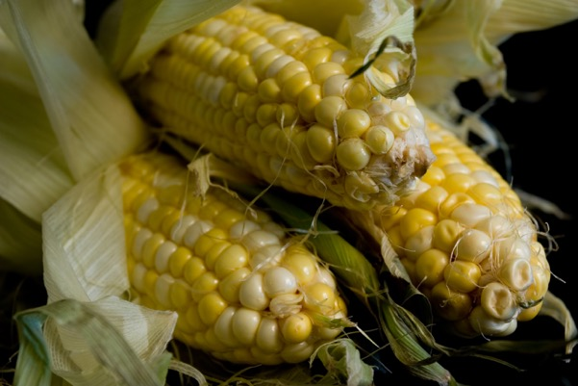
Analyze the purchasing habits of your perspective customers
  Shopping location
  Purchase frequency
  Product preferences
Test your message

Slide 28
Summary
Develop brand and frame a message to prompt consumers to associate your product with your message
Words and images can hold multiple meanings
Tips to select images and words
Steps to effective messages
Testing your message

Slide 29
ANY QUESTIONS?
EVALUATIONS

