Slide 1
Module 5: How do you talk to consumers about your locally grown food? – Part 1

Slide 2
In our previous session we discussed:
Advantages and disadvantages of different media channels
Existing branding programs available to producers
Steps to creating a personalized brand
Effective marketing strategies
Incorporating of media channels and marketing strategies into your promotional plan

Slide 3
Agenda
Objectives
Achieving transparency
Two-way communication
Risk communication
Summary
Evaluation

Slide 4
Objectives
Understand and apply transparent communications techniques
Use two-way communication and know its benefits
Recognize what pro-active risk communication is and how to apply appropriate techniques

Slide 5
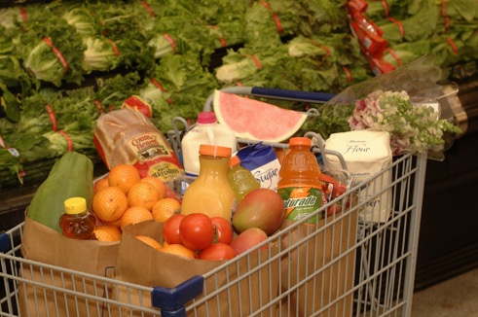
Achieving Transparency
Definition: Sharing all information, both positive and negative, with the consumer

Slide 6
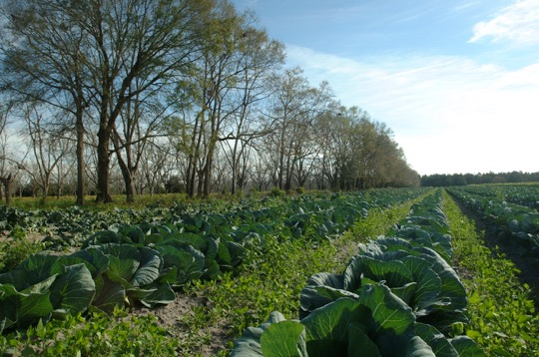
Benefits of Transparency for the Consumer
Can make informed decisions
Understand the product

Slide 7
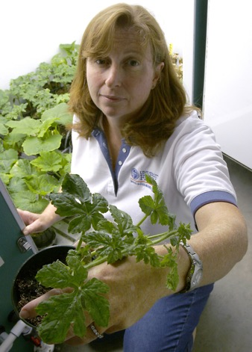
Benefits of Transparency for the Producer
Builds customer trust
Helps overcome loss of trust
Aids in recovery from skepticism
Enhances accountability and commitment

Slide 8
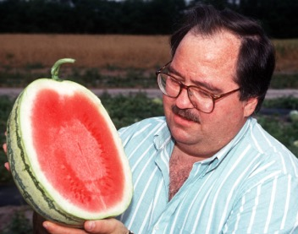
Transparent Communications Include information that meets the needs of your consumers.
Questions to pinpoint information:
Will my target audience feel this information is relevant?
Will my audience understand the information clearly?
Am I providing complete information?

Slide 9
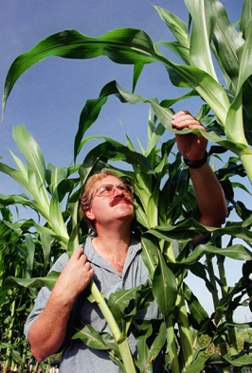
Questions to pinpoint information:
Am I providing accurate information?
How reliable is the information I am providing?
How timely is the information I am providing?
Are other sources providing comparable information?

Slide 10
Exercise A
Write a short paragraph telling potential customers about a favorite crop you produce.
Your message should contain information that would persuade consumers to purchase your product, such as the actions you take to make certain your product is safe and a good purchase.
Following the completion of your story, you will be asked to share your draft and have the opportunity for feedback from other participants about the transparency of your message.

Slide 11
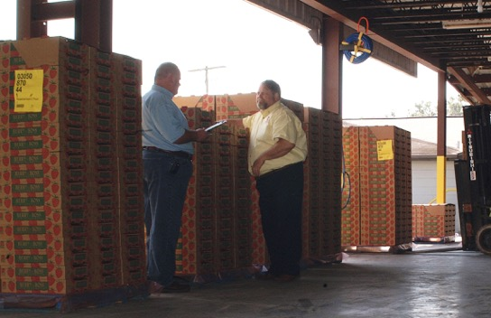
Two-Way Communication
Definition: Providing information and requesting that receivers give feedback to establish a conversation
Consumers desire to participate in the communication process

Slide 12
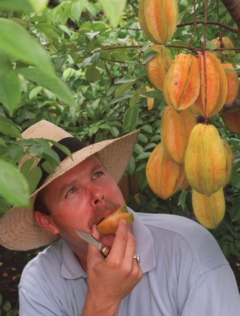
Questions to help build two-way communication:
Have I invited the audience to be involved in communication?
Have I invited the audience to give feedback?
Have I answered audience feedback that required a response?

Slide 13
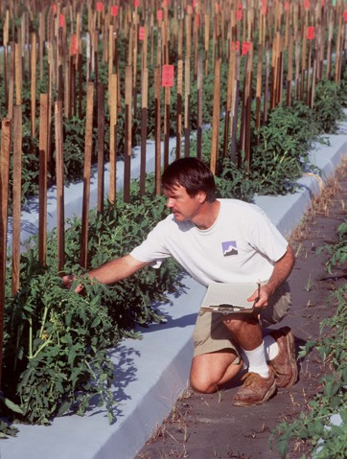
Questions to help build two-way communication:
Am I providing enough detail in the information?
Is the information available and easy to find?
Have I tried to understand and solicit consumer opinion?

Slide 14
Exercise B
In the first column on your worksheet, list communication channels you feel are appropriate to establish two-way communication between your business and customers.
The second column provides space for you to record how you would use each channel to provide two-way communication in your promotion plan.
After you fill in your worksheets, we will collect group input and create a master list.

Slide 15
Accountability
Transparency requires that a business be accountable
Questions to evaluate accountability in communication:
Am I providing material about all sides of a controversial topic?
Am I providing information that may hurt my business?
Does the information I am providing match Industry standards?
Have I communicated any mistakes my organization has made?

Slide 16
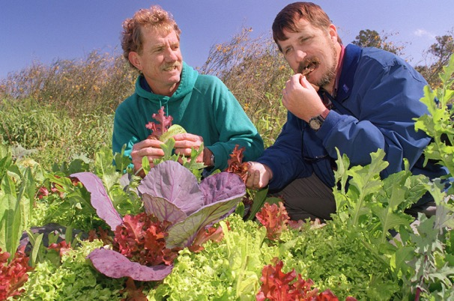
Important!
Transparent communication may not include all components in each message
Yet, all components should be evident in your overall communication

Slide 17
Risk Communication
Relays information effectively about situations of a crisis or emergency nature
Communicates about health or environmental issues
Facilitates goodwill through managing problems
Fosters practical actions and controls anxiety

Slide 18
Risk Communication (continued)
The principles of transparent communication should be applied to your risk communication.
Risk communication topics include issues such as:
Pesticide/herbicide safety
GMO usage
E. coli/Salmonella contamination prevention

Slide 19
Three components to risk communication
The message
Information you wish your audience to understand
Needs to inform and persuade
Message goal: audience comprehension and action
The medium
The avenue you select to communicate about the situation
The audience
Various populations experience risk differently

Slide 20
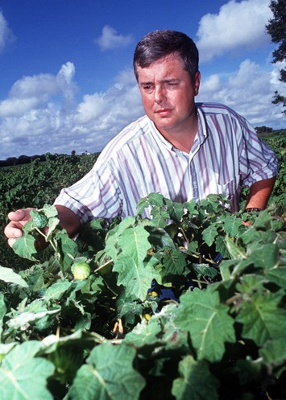
Two Categories of Risk Perception
Objective risk: Information driven
Subjective risk: The perception of objective risk
Influenced by
Knowledge of risk
Level of fear
Ability to control

Slide 21
Rules for Risk Communication
Acknowledge the public as a partner and involve them in the situation.
Develop strategies carefully and evaluate you actions.
Listen with an open mind to audience issues.
Show your sincerity, honesty and concern.

Slide 22
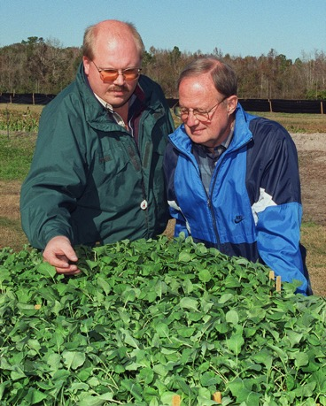
Rules for Risk Communication (continued)
Partner with trustworthy experts
Work with the media
Use clear, simple words that show concern for the public

Slide 23
Exercise C
You will find a short scenario about a consumer concern on your worksheet.
Using the information we discussed on risk communication, prepare a short paragraph you would use to address the public concerns arising from this scenario.
Following the completion of your story, you will be asked to share your draft and have the opportunity for feedback from other participants about the transparency of your message.

Slide 24
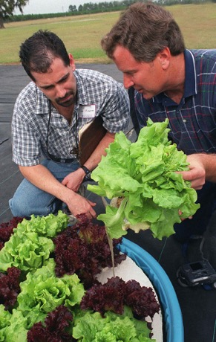
Summary
Transparent communication techniques
Two-way communication and its benefits
Recognizing and applying good risk communication

Slide 25
ANY QUESTIONS?
EVALUATIONS

