Slide 1
Module 6: How do you talk to consumers about your locally grown food?

Slide 2
Review
Branding: A distinguishing name or symbol used to differentiate your product from your competitors
Framing: A method of using words and images to make your message more easily understood and called to mind

Slide 3
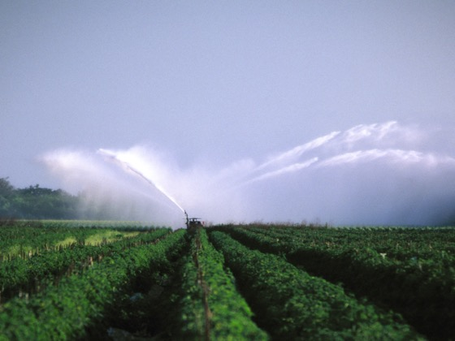
Review (continued)
Communications channels
Personalized brands and effective marketing plans
Transparent communication, two-way communication, and risk communication

Slide 4
Agenda
Objectives
Developing your story
Sharing your story
Making your story meaningful to your audience
Summary
Evaluation

Slide 5
Objectives
Understand methods of storytelling as a way to connect your products and farm to consumers and the media
Identify effective ways to share your story
Frame your story to match you audience
Incorporate into your draft story into your promotional plan

Slide 7
Crafting your story and being able to share it successfully will help people make an emotional connection with you and your business.
If you can elicit a positive emotional response from an individual, they will be more likely to remember you, your business and how you made them feel.

Slide 8
Three elements to develop your story
Who is the lead character (the protagonist)?
What is the goal of your story? What is the lead character trying to accomplish?
What roadblocks or barriers must the lead character overcome to accomplish this objective?

Slide 10
The Elements
The leading character:
The goal:
The barrier:

Slide 11
The Elements
The leading character: Narrator/Farmer
The goal:
The barrier:

Slide 12
The Elements
The leading character: Narrator/Farmer
The goal: Preserve farm, provide for children
The barrier:

Slide 13
The Elements
The leading character: Narrator/Farmer
The goal: Preserve farm, provide for children
The barrier: Husband’s death, skeptics

Slide 14
Exercise A
Who is the lead character (the protagonist) in your story?
What is the goal of your story? What is the lead character trying to accomplish?
What roadblocks or barriers must the lead character overcome to accomplish these goals?

Slide 15
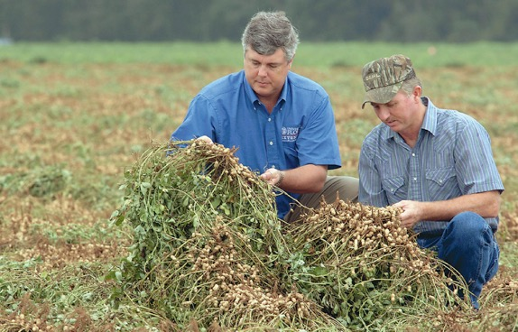
A well-developed story generally includes:
Expressive details
Multiple obstacles
Logical progression or action
A worthy goal

Slide 16
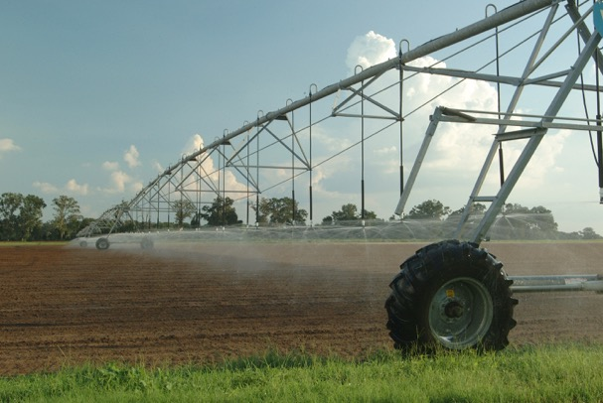
Story organization method
AABT
And, And, But, Therefore

Slide 17
I am a small farmer who runs a 4th generation strawberry farm and I am trying to save my business. My small farm is facing increasing costs, competition, and labor challenges and finding a way for the our farm to be more profitable is essential, but I have been unable to find solutions that improve the income of the farm. If I do not find significant cost reductions our family farm will have to close. My family enjoys our strawberry farm and wants to maintain our business. Therefore, I am seeking to expand our operation to a u-pick for the last few weeks of our strawberry season.

Slide 18
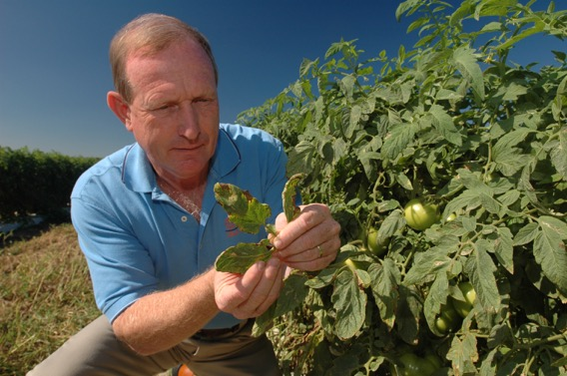
Exercise B
A well-developed story generally includes:
Expressive details
Multiple obstacles
Logical progression or action
A worthy goal
And, And, But, Therefore

Slide 19
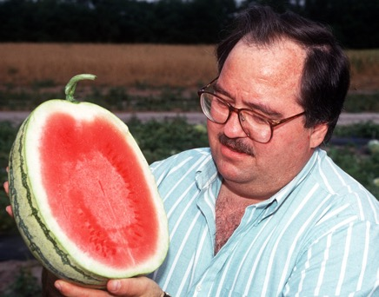
Sharing your Story
Be prepared with a well-developed story
Tailor the story to the audience
Include a primary message the audience can relate to

Slide 20
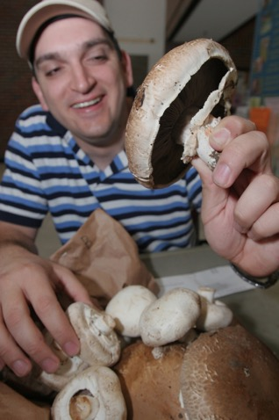
Sharing your Story (continued)
Analyze your audience
Show how your business relates to the audience
Match your story to the audience you are targeting

Slide 21
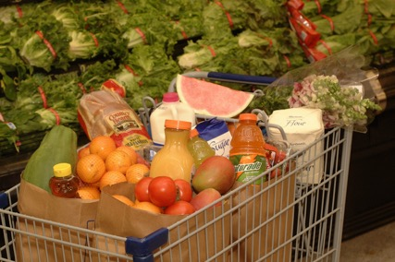
Sharing your story (continued)
Focus on a primary point
Create the emotional connection
Emphasize this message strongly
Support your core message with the details of your story

Slide 22
I am a small farmer who runs a 4th generation strawberry farm and I am trying to save my business. Running a profitable farming business has gotten more challenging in the last 5 years. My small farm is facing increasing costs, competition, and labor challenges and finding a way for the our farm to be more profitable is essential, but I have been unable to find solutions that improve the income of the farm. If I do not find significant cost reductions our family farm will have to close. My family enjoys our strawberry farm, it’s who we are, and it’s important that we maintain our business. Therefore, I am seeking to expand our operation to a u-pick for the last few weeks of our strawberry season.

Slide 23
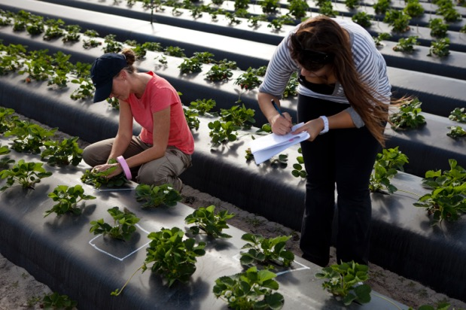
Find the audience’s interests
Special products
Community
Customer service
Acceptable farm methods

Slide 24
My family and I own Charlie’s Strawberry Farm. Farming, the smell of fresh strawberries, and spending time outside with family has always been our way of life. But our way of life has faced uncertainty in recent years, as it has become more challenging for small farmers to stay in business. We are fighting to save our business so that we can continue to share our fresh Florida strawberries with you and your family. We take great pride in our community and enjoy greeting visitors with a friendly smile, a sweet treat, and fun-filled day of adventures on the farm. Many of our customers leave with their pick of fresh Florida strawberries, smiles, pictures, and memories to last a lifetime. We want you and your family to experience the beauty and taste of farm fresh strawberries. Come spend a day with us and make memories on the farm.

Slide 25
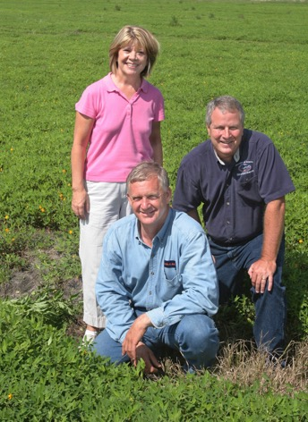
Exercise C
Adjust your story to focus on the primary point
Show how your business meets audience needs
Create emotional connection

Slide 26
Summary
Creating a well-developed story
Understanding the core elements that make a well-developed story
Sharing your story
Making your story meaningful to your audience

Slide 27
ANY QUESTIONS?
EVALUATIONS

