Slide 1
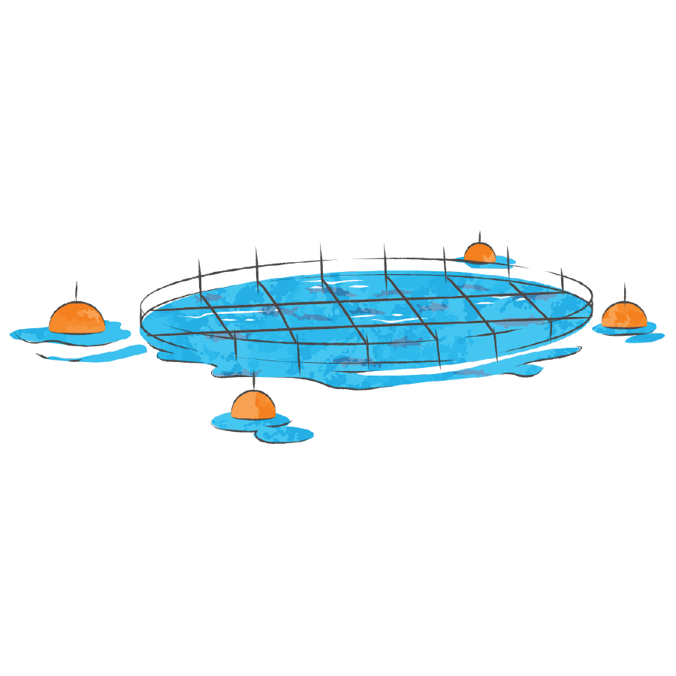
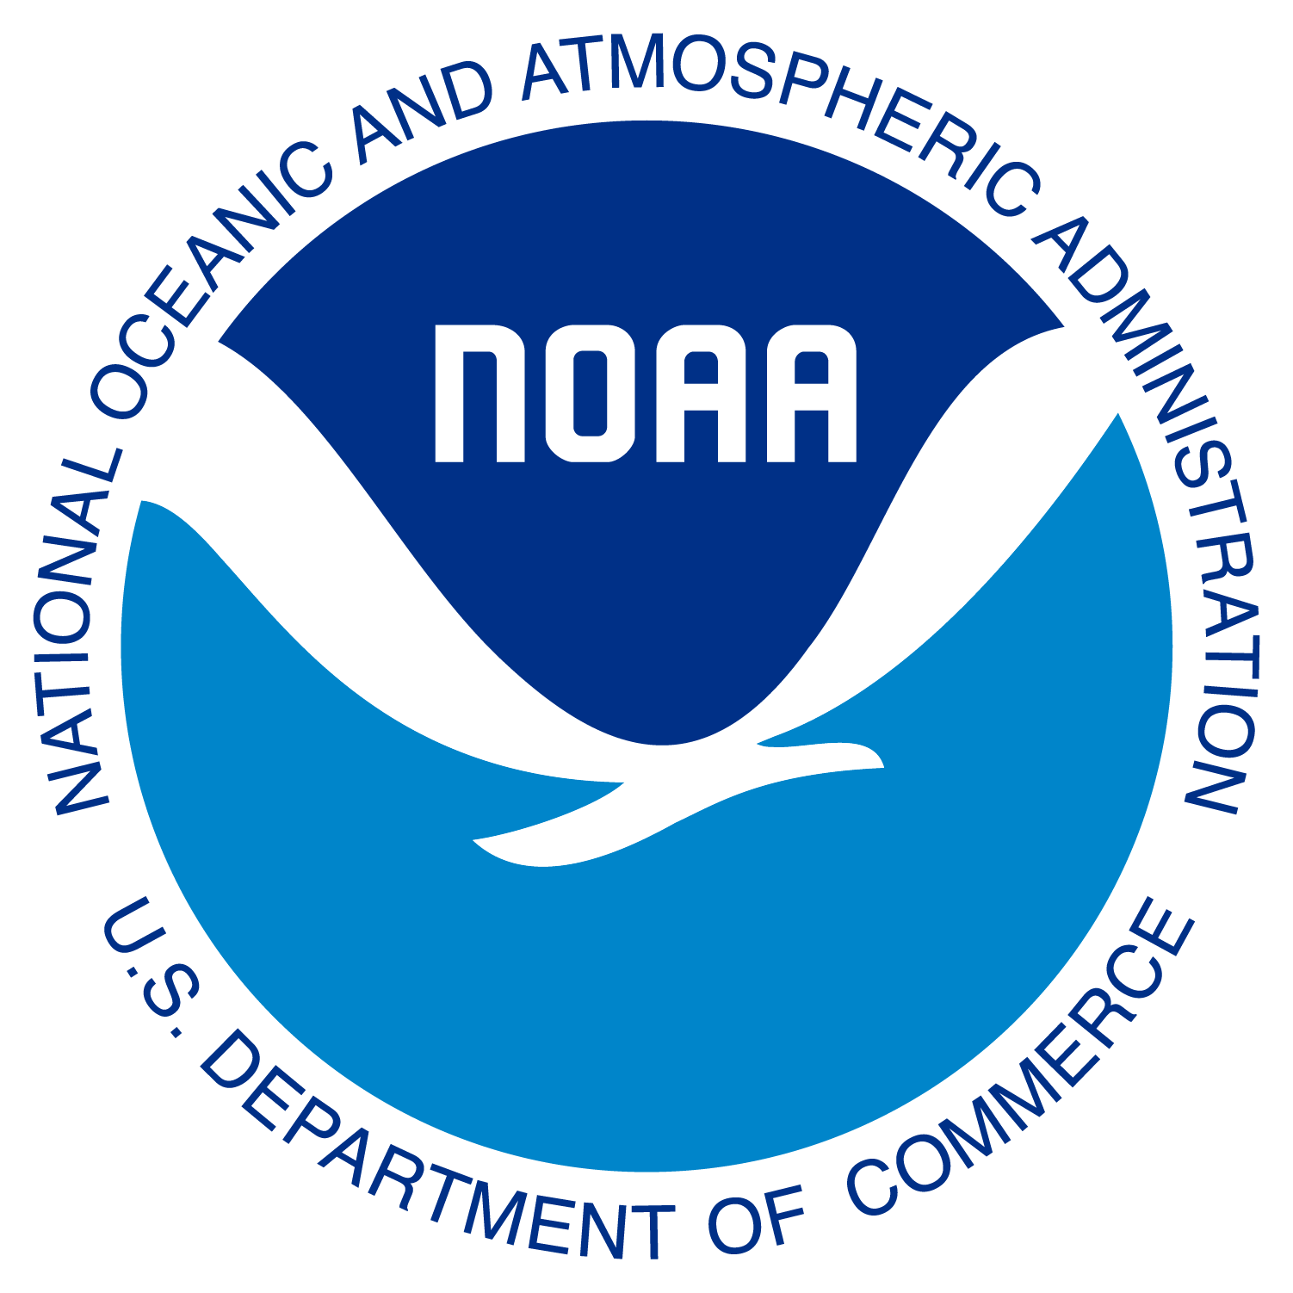
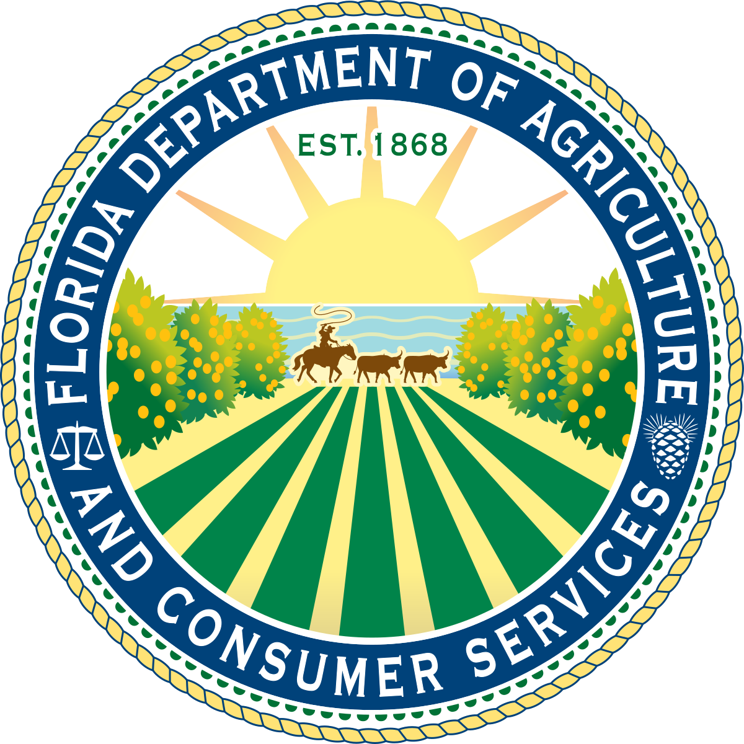
OFFSHORE AQUACULTURE IN FLORIDA

Slide 2
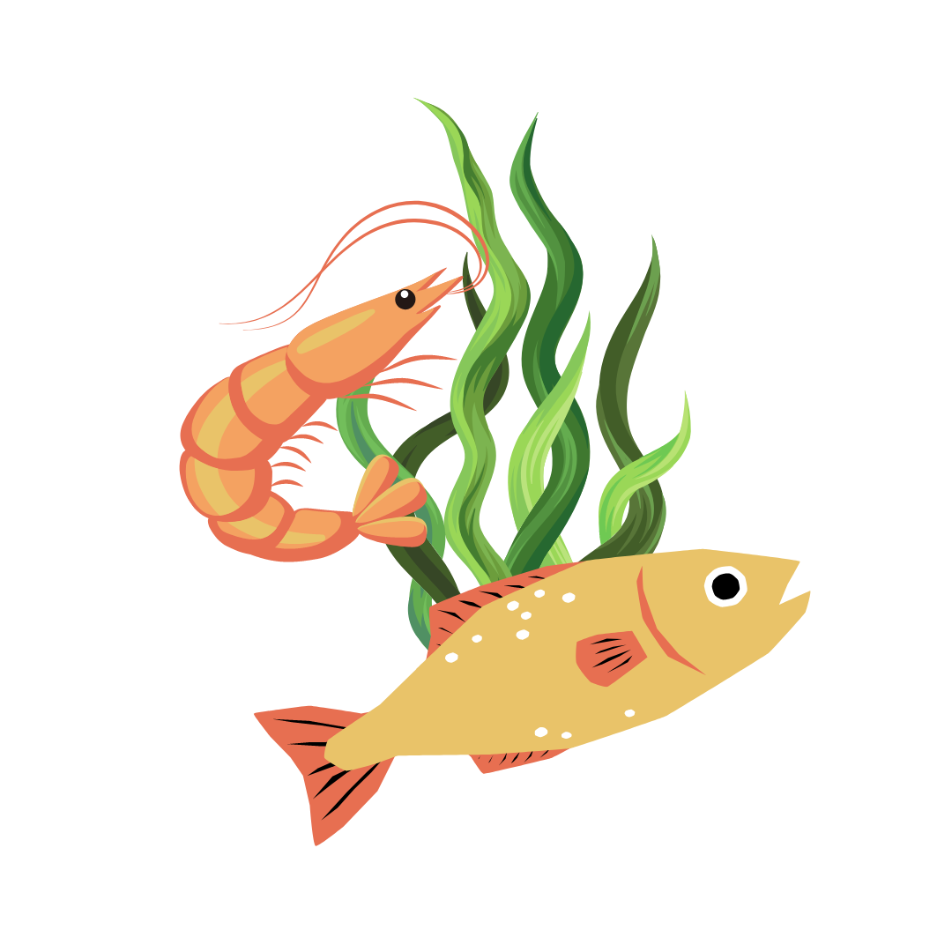
What is aquaculture?
Aquaculture simply means farming in water.
Aquaculture involves breeding, raising, and harvesting aquatic organisms in water.
Aquatic organisms include finfish, bivalve shellfish, shrimp, and other invertebrates, aquatic reptiles, and aquatic plants
Farmed for the ornamental aquarium trade, food, conservation, and other uses
Notes:
Aquaculture simply means farming in water.
Aquaculture involves breeding, raising, and harvesting aquatic organisms in water.
These aquatic organisms include finfish, bivalve shellfish, shrimp, and other invertebrates, aquatic reptiles, and aquatic plants.
They are farmed for the ornamental aquarium trade, food, conservation, and other uses.

Slide 3
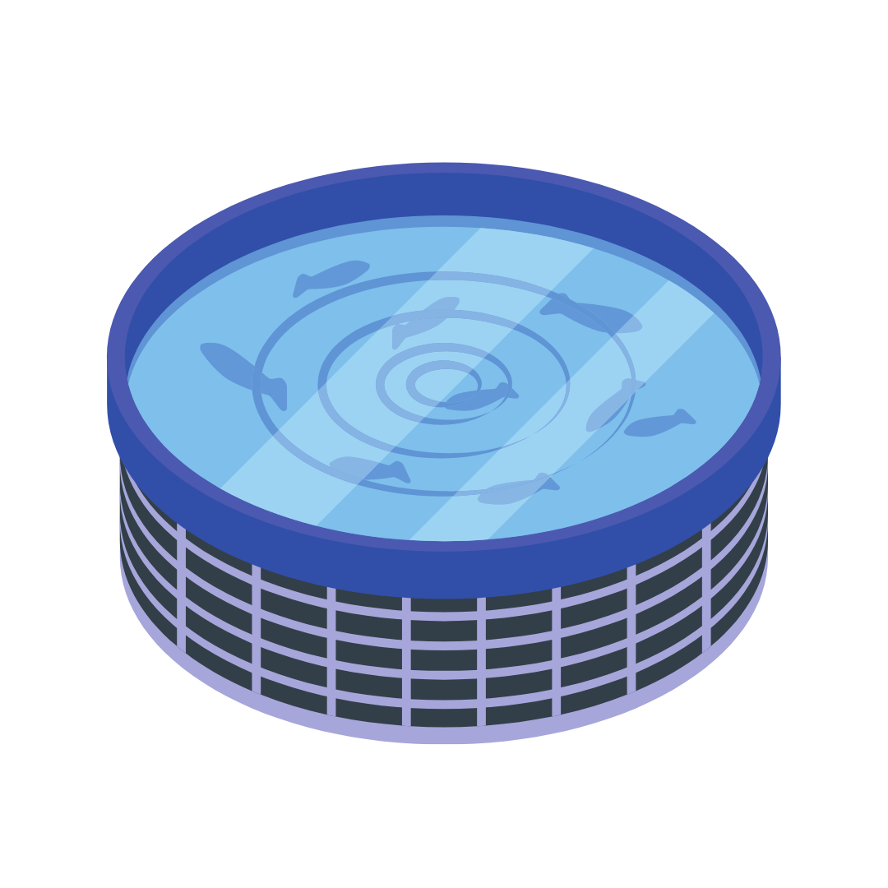
What is aquaculture?
Aquaculture can take place in either freshwater or saltwater.
Can occur in tanks or ponds
Notes:
Aquaculture can take place in either freshwater or saltwater.
Aquaculture can occur in tanks or ponds.

Slide 4
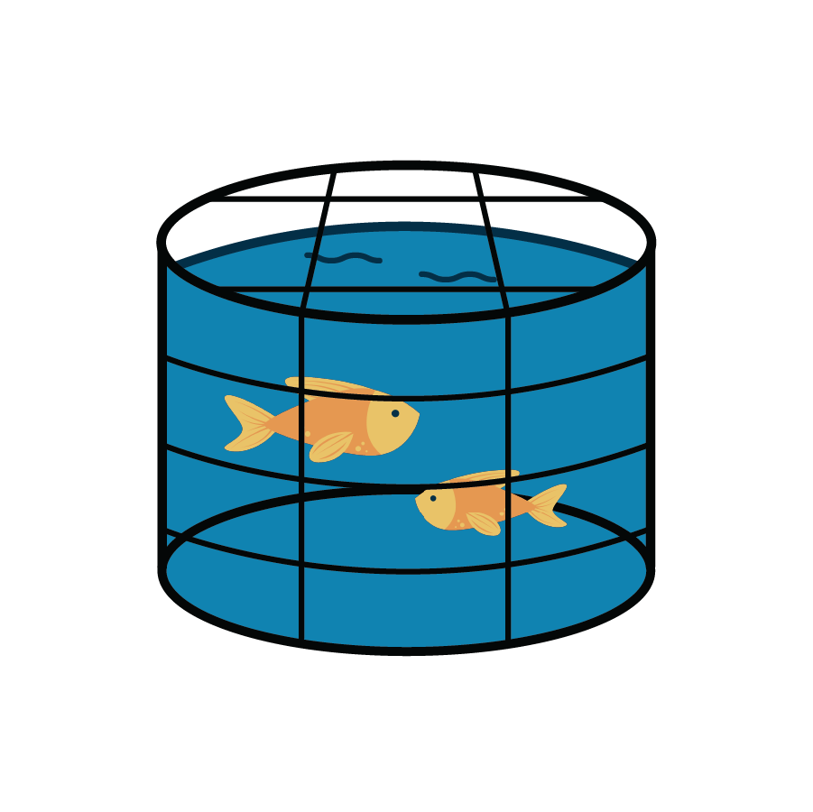
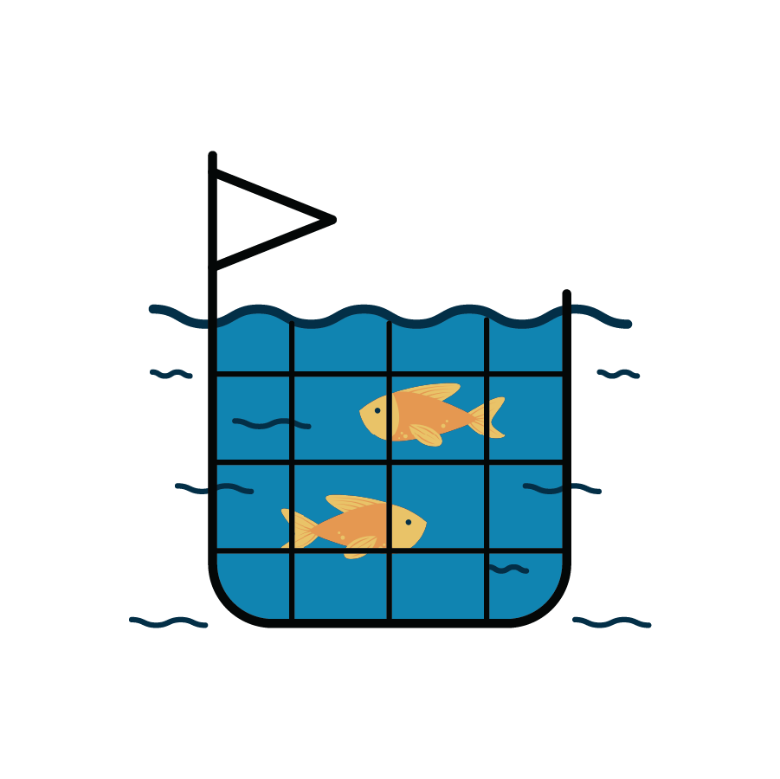
What is aquaculture?
Aquaculture can be onshore or offshore.
Nearshore operations are a type of offshore aquaculture that occurs directly on the coast in state waters.
Onshore operations are land-based systems and can include docks.
Offshore operations occur in open waters away from land.
Notes:
Aquaculture can be onshore or offshore.
Onshore operations are land-based systems and can include docks.
Offshore operations occur in open waters away from land.
Nearshore operations are a type of offshore aquaculture that occurs directly on the coast in state waters.

Slide 5
Offshore aquaculture in Florida.
Offshore aquaculture involves farming native marine organisms using marine systems that are submerged underwater and suspended off the seafloor.
Ongoing research projects with state, federal, and academic partners will help determine possible areas in Florida state waters of the Gulf of Mexico for offshore aquaculture operations.
Notes:
Offshore aquaculture involves farming native marine organisms using marine systems that are submerged underwater and suspended off the seafloor.
Native marine organisms are raised in and harvested from these underwater systems.
Ongoing research projects with state, federal, and academic partners will help determine possible areas in Florida state waters of the Gulf of Mexico for offshore aquaculture operations.

Slide 6
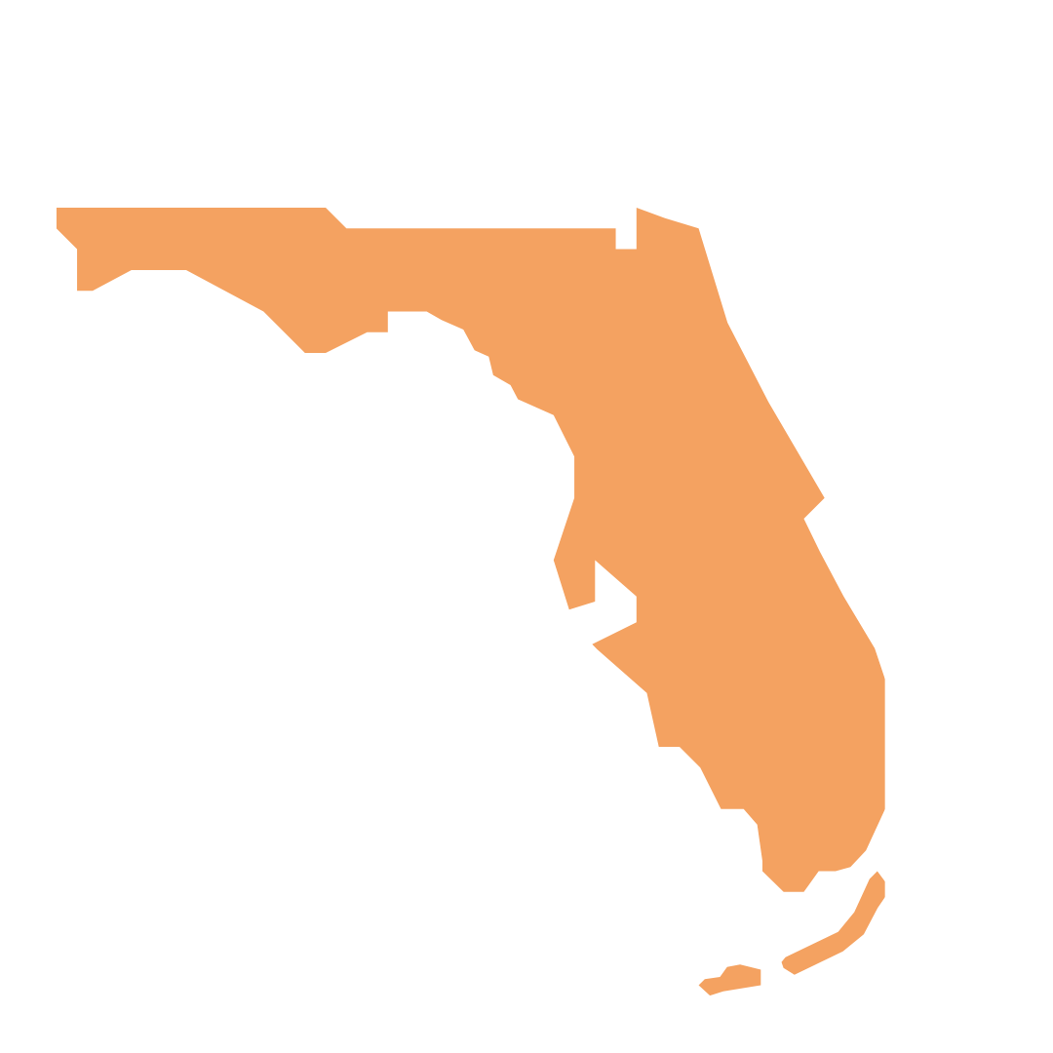
Offshore aquaculture in Florida.
Florida’s vast coastal region, climate, and shipping opportunities make it ideal for offshore aquaculture and the production of unique, valuable seafood products.
FDACS Division of Aquaculture is a “one-stop shop” for Florida’s aquaculture regulations and is recognized as a national leader in aquaculture regulation and development.
Notes:
Florida’s vast coastal region, climate, and shipping opportunities make it ideal for offshore mariculture and the production of unique, valuable seafood products.
Additionally, the Florida Department of Agriculture and Consumer Services (FDACS), Division of Aquaculture is a “one-stop shop” for Florida’s aquaculture regulations and is recognized as a national leader in aquaculture regulation and development.

Slide 7
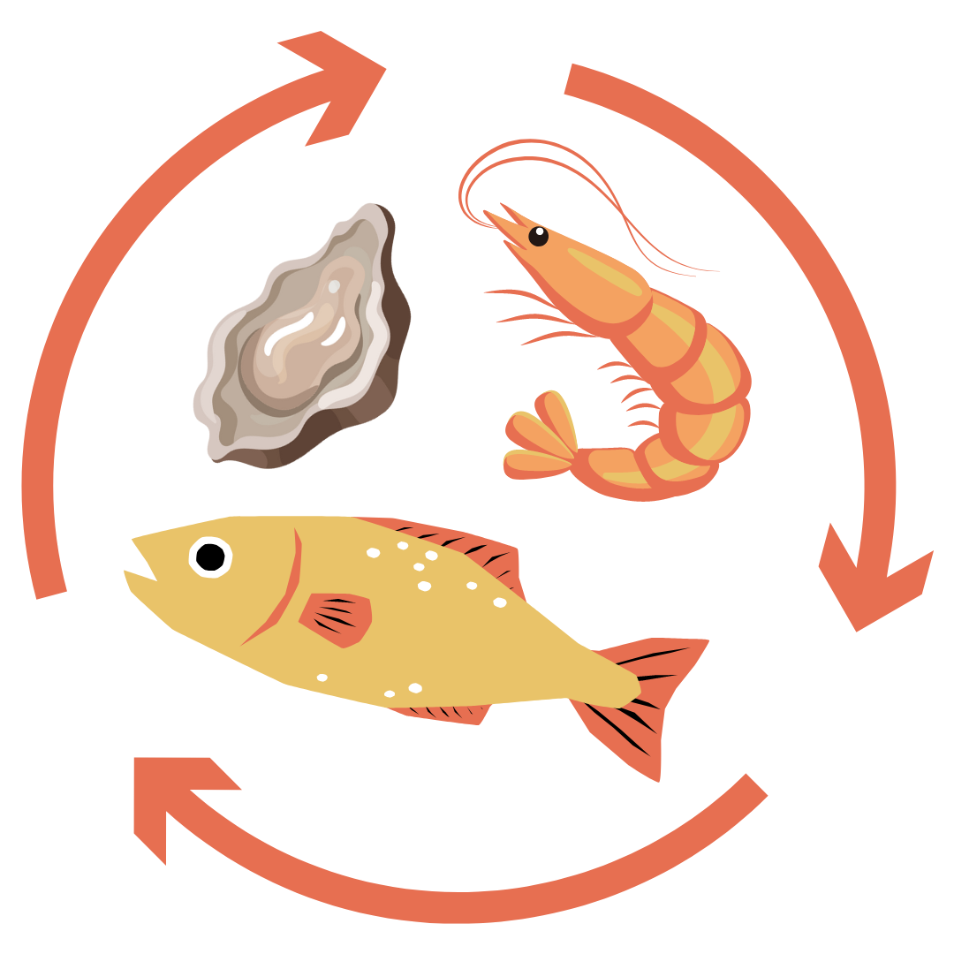
Why is offshore aquaculture beneficial?
Expand domestic seafood production in the U.S. and increase food security
According to FAO, 52% of seafood consumed globally is farmed¹
Prepare to meet future protein demands and work towards achieving several United Nations’ Sustainable Development Goals by 2030²
Notes:
Offshore aquaculture operations in the U.S. can expand our domestic seafood production and increase our food security.
According to the Food and Agriculture Organization of the United Nations (FAO), 52% of seafood consumed globally is farmed.
Responsible offshore aquaculture practices can prepare us to meet future protein demands and achieve several United Nations’ Sustainable Development Goals by 2030 (NOAA Fisheries).

Slide 8
Why is offshore aquaculture beneficial?
Help take the pressure off wild-capture fishery resources and supplement sustainable wild-capture fisheries
Enhance employment and economic opportunities in coastal communities and support the Blue Economy³
Notes:
Offshore aquaculture can help take the pressure off wild-capture fishery resources and supplement sustainable wild-capture fisheries.
Offshore aquaculture operations can enhance employment and economic opportunities in coastal communities.
This supports the Blue Economy, which are jobs and industries that rely on ocean resources.

Slide 9
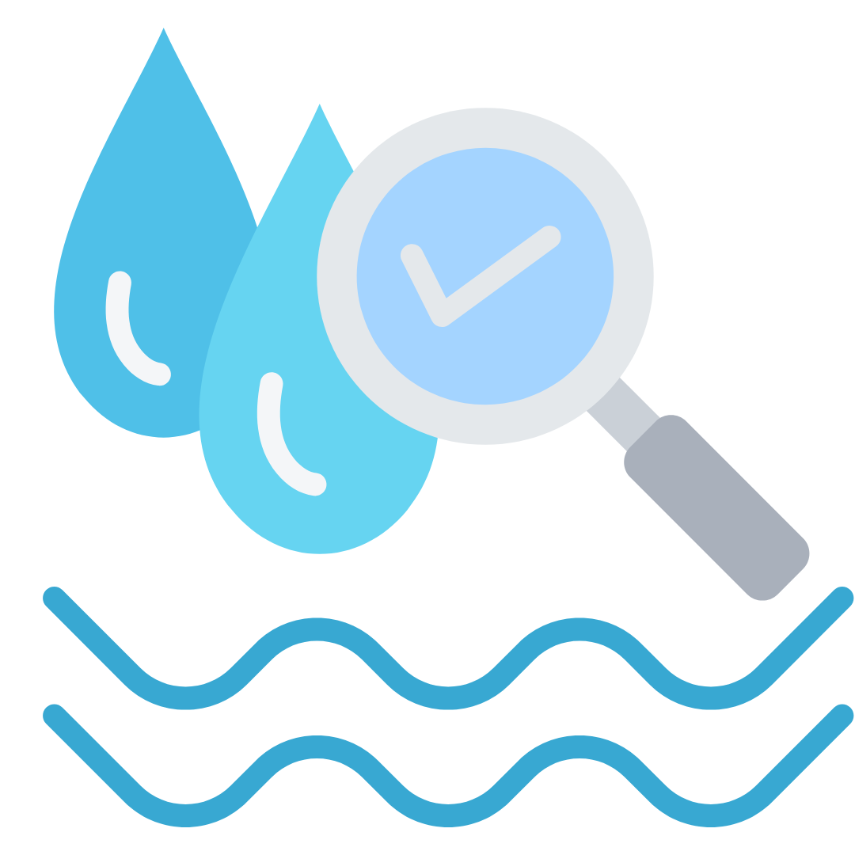
How are environmental concerns being addressed?
NUTRIENT POLLUTION
As a best practice, marine systems are placed in deep waters with currents that allow for flushing to reduce the buildup of nutrients.
Florida requires rigorous environmental assessments and compliance with water quality regulations such as the Clean Water Act.
Nutrients are nearly undetectable outside of the system when offshore operations are properly sited and managed.
Notes:
Water quality is an important environmental concern related to aquaculture.
As a best practice, marine systems are placed in deep waters with currents that allow for flushing to reduce the buildup of nutrients.
Florida also requires rigorous environmental assessments and compliance with water quality regulations such as the Clean Water Act.
When offshore operations are properly sited and managed, nutrients are nearly undetectable immediately outside of the system.

Slide 10
How are environmental concerns being addressed?
FISH ESCAPES
Proper animal husbandry, routine system maintenance, and escape recovery plans will prevent and manage fish escapes to protect natural resources.
Escaped farmed fish will also likely die, quickly become prey, or fail to reproduce due to their decreased fitness in the wild.⁴
Notes:
Fish escapes present a potential risk to the natural environment and wild fish populations via competition and spread of disease.
Proper animal husbandry, routine system maintenance, and escape recovery plans will prevent and manage fish escapes to protect natural resources.
Escaped farmed fish will also likely die, quickly become prey, or fail to reproduce due to their decreased fitness in the wild.

Slide 11
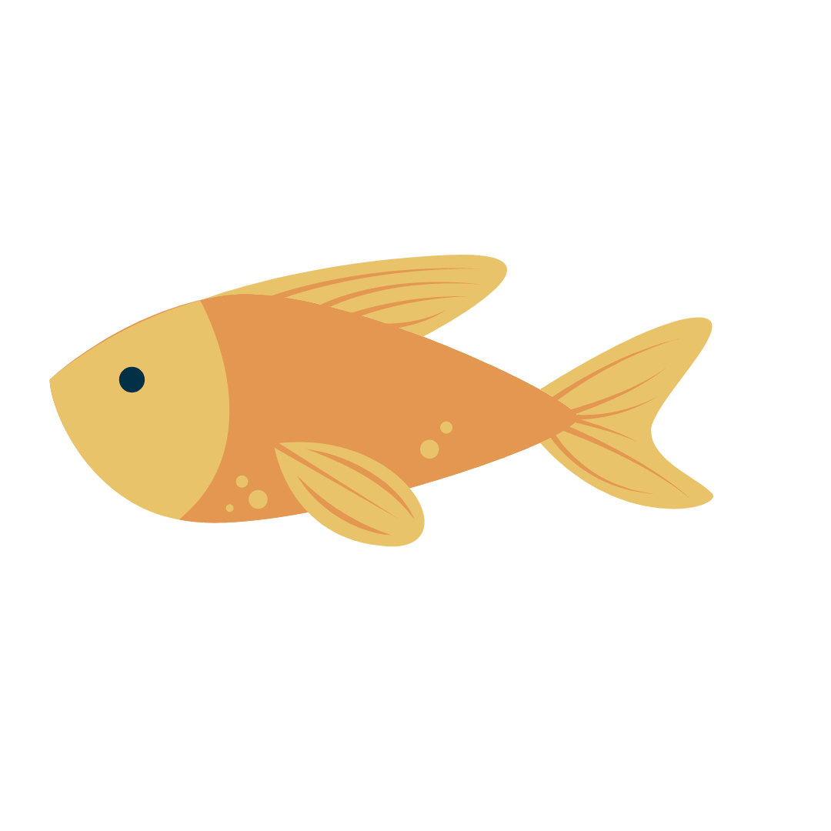
How are environmental concerns being addressed?
MIXING WITH NATIVE FISH
Farmed species MUST be native and originate from local genetics of the wild population.
Non-native and transgenic, or genetically altered, organisms are strictly prohibited for farming in Florida state waters.
Notes:
Concern exists that farmed fish could mix with wild fish populations and produce negative genetic consequences.
Farmed species in Florida MUST be native and originate from local genetics of the wild population.
Non-native and transgenic, or genetically altered, organisms are strictly prohibited for farming in Florida state waters.

Slide 12
How are human health concerns being addressed?
USE OF PREVENTATIVE TREATMENTS
Proper animal husbandry and care to prevent disease is an industry-standard best practice to avoid the use of expensive treatments.
The high cost, intensive labor required, and strict regulations involved to use preventative treatments restricts their use in all but the most severe cases.
Notes:
Public concern exists related to the use of preventative treatments in offshore aquaculture operations potentially causing human health risks or antibiotic resistance.
Proper animal husbandry and care to prevent disease is an industry-standard best practice to avoid the use of expensive treatments.
The high cost, intensive labor required, and strict regulations involved to use preventative treatments restricts their use in all but the most severe cases.

Slide 13
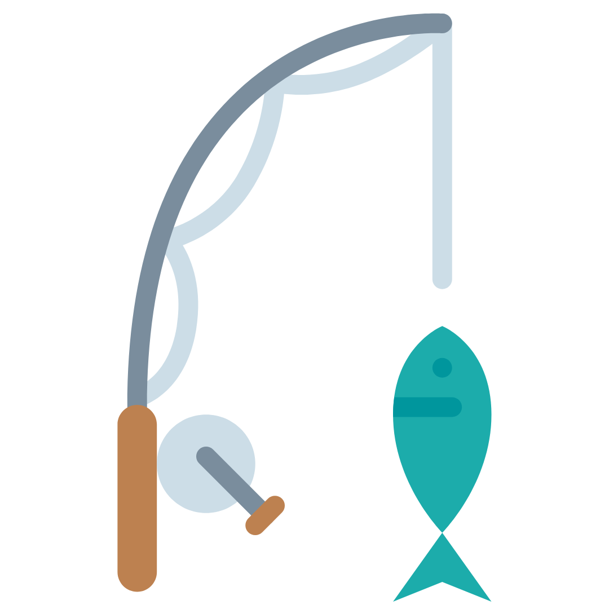
How are economic and social concerns being addressed?
IMPACT ON LOCAL ECONOMY AND FISHING COMMUNITIES
Offshore aquaculture can present numerous opportunities for economic growth, jobs in rural and working waterfront communities, enhanced domestic food security, and preservation of coastal heritage and traditions.
Notes:
There is concern that this growing industry may compete with or displace existing fishers and other ocean users.
However, offshore aquaculture can present numerous opportunities for economic growth, jobs in rural and working waterfront communities, enhanced domestic food security, and preservation of coastal heritage and traditions.

Slide 14
How are economic and social concerns being addressed?
MARINE NAVIGATION AND ACCESS TO FISHERS
A sufficient distance must exist between offshore aquaculture operations and marine traffic routes to avoid both disrupting navigation and impacting access to fishers.
Notes:
A sufficient distance must exist between offshore mariculture operations and marine traffic routes to avoid both disrupting navigation and impacting access to fishers.

Slide 15
References/Additional Resources
Food and Agriculture Organization of the United Nations, The State of World Fisheries and Aquaculture
National Oceanic and Atmospheric Administration’s Fisheries, Aquaculture Supports a Sustainable Earth
National Oceanic and Atmospheric Administration’s National Ocean Service, Our Ocean Economy
National Oceanic and Atmospheric Administration’s Fisheries, Potential Risks of Aquaculture Escapes

